Slide 1
DIVISION OF VIRGIN ISLANDS CULTURAL EDUCATION JUNE 2017
HISTORICAL CALENDAR

Slide 2
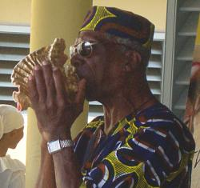
SPECIAL TRIBUTE CELEBRATION OF MEN CONTRIBUTING TO MUSIC IN THE USVI
Mr. Wilfred “Junie Bomba” Allick, Jr.
Musician
St. Croix, USVI
Mr. Stanley Jacobs
Musician and Band Leader,
Stanley & the Ten Sleepless Knights
St. Croix, USVI
Pictures Courtesy of:
Wilfred “Junie Bomba” Allick, Jr.: http://stcroixsource.com/content/news/local-news/2011/04/02/quelbe-choirs-music-series-lifts-every-voice
Stanley Jacobs: http://stcroixsource.com/content/arts-entertainment/music/2010/06/08/stanley-ten-sleepless-knights-performing-quelbe-music-40

Slide 3
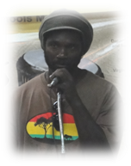
SPECIAL TRIBUTE CELEBRATION OF MEN CONTRIBUTING TO MUSIC IN THE USVI
Mr. Alvin “Jupiter” Pickering
Musician, Inner Vision Band
St. John, USVI
Mr. Ira “Dr. Sax” Meyers
Musician, Milo’s Kings
St. Thomas, USVI
Pictures Courtesy of:
Division of Virgin Islands Cultural Education

Slide 4
JUNE 1st:
1908:
Myrah A. Keating Smith was born on St. John. She was a nurse and midwife, who devoted 45 years to the profession mostly on St. John.
Courtesy of:
Text: Profiles of Outstanding Virgin Islanders, Ruth Moolenaar
Picture: http://webpac.uvi.edu/imls/pi_uvi/profiles1992/Sci_Econ_Hlth_Admin/Smith_KM/index.shtml

Slide 5
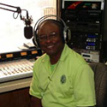
JUNE 2nd:
1935:
Irvin Delano “Brownie” Brown was born in Savan, St. Thomas. He is a world class drummer and percussionist in classical, Samba, Latin, Calypso, Blues and Jazz for almost 60 years. He is a renowned MC and radio personality for over 43 years promoting VI culture, values and traditions.
Courtesy of:
Text: Legislative Act
Picture: http://www.lucky13wsta.com/documents/programs.php

Slide 6
JUNE 3rd:
1970:
The Department of Commerce prepared for the loss of Tourism Chief, Mr. Harry Goeggel. His planned retirement was after 21 years in the industry.
Courtesy of:
Text: Thoughts Along The Way, Page 429
Picture: http://prescottpr.com/portfolio/

Slide 7
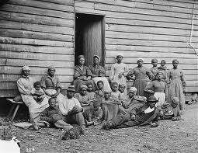
JUNE 4th:
1839:
A Royal Ordinance was issued requiring free and compulsory education for all free colored and some slaves in the Danish West Indies.
Courtesy of:
Text: The Umbilical Cord, HWL Willocks, page 16
Picture: http://www.tnhistoryforkids.org/stories/free_blacks

Slide 8
JUNE 5th:
1925:
After much preparation, the St. Thomas Community Band made its debut at the Apollo Theater in St. Thomas.
Courtesy of:
Text: Legislative Act
Picture: http://www.viennacommunityband.org/directors.php

Slide 9
JUNE 6th:
1924:
Rufus Alphonso Graham was born to James and Lolita Graham nee Mars on St. Thomas. He was the first Black stenographer at the United Nations - 1947 to 1960.
Courtesy of:
Text: Funeral Booklet
Picture: http://captainplaid.blogspot.com/2008_06_01_archive.html

Slide 10
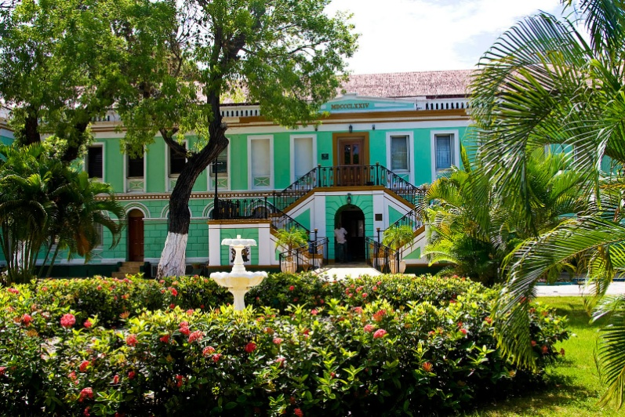
JUNE 7th:
1957:
An editorial headline, “A Good Record”, observed that that the Second Legislature conducted the first session in a way that all residents could feel a sense of pride in its accomplishments. It was undoubtedly the most fruitful session held since the old Colonial Law was abolished in 1936.
Courtesy of:
Text: Thoughts Along the Way, Page 175
Picture: http://svanhinga.blogspot.com/2010_06_01_archive.html

Slide 11
JUNE 8th:
1967:
As the Elective Governor Bill made its way through US congressional committees, the Daily News warned the residents that the bill was no panacea for the territory.
Courtesy of:
Text: Thoughts Along The Way, Page 383
Picture: http://www.crimestoppersusvi.org/sponsors.aspx

Slide 12
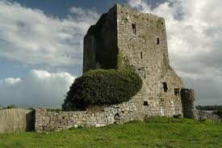
JUNE 9th:
1874:
A public meeting of the planters was held at Estate Castle Burke on the matter of establishing a credit association and central factories on St. Croix.
Courtesy of:
Text: From Serfdom to Fireburn, and Strike by Peter Hoxcer Jensen, Pages 130 and 242
Picture: http://irishrosephotography.com/-/irishrosephotography/gallery.asp?LID=&cat=66414&pID=2&row=15&photoID=4728529&searchTerm=

Slide 13
JUNE 10th:
1961:
The Daily News chastised the Legislature for not addressing major issues such as zoning and sub-division law for the islands, along with a compulsory automobile insurance bill. The editorial concluded that “the accomplishment of the Legislature could not even fit on the back of a stamp”.
Courtesy of:
Text: Thoughts Along The Way, Page 302
Picture: http://www.crimestoppersusvi.org/sponsors.aspx

Slide 14
JUNE 11th:
1967:
Dion Parson, world renowned drummer, band leader for 21st Century Band, drum/percussion, jazz instructor and recording artist, was born on St. Thomas.
Courtesy of:
Text: Reichhold Center Stagebill: The Homecoming of 21st Century Band, Page 9
Picture: Division of VI Cultural Education file

Slide 15
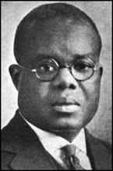
JUNE 12th:
1917:
Writer, teacher, orator, editor, union leader, Hubert H. Harrison called a mass meeting of 2,000 strong Negro American Liberty League at the Bethel African Methodist Episcopal Church in NY. He endorsed and introduced his mentee Marcus Garvey, which launched one of the largest African movements of the 20th century, the United Negro Improvement Association.
Courtesy of:
Text: From These Shores, Axel Hansen, page 114
Picture: http://blackmanguidetothinking.blogspot.com/

Slide 16
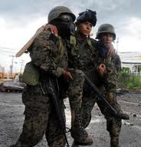
JUNE 13th:
1945:
The Photo News endorsed a Progressive Guide publication article, which called for the need to provide readjustment services to returning servicemen with health problems, disabled, unemployed, and otherwise needy.
Courtesy of:
Text: The Photo News newspaper editorial page
Picture: http://www.hurriyetdailynews.com/ix.php?p=6&as_epq=chechnya

Slide 17
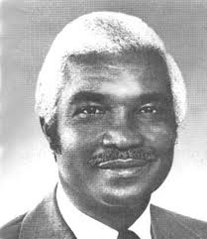
JUNE 14th:
1954:
Cyril E. King cabled the Legislative Assembly asking that they annul their agreement with Irwin Silvermann’s Law Firm due to the attorney’s attack on the NAACP, who zealously supported the Revised Organic Act.
Courtesy of:
Text: Daily News
Picture: http://cruzansyndicate.tripod.com/page2.htm

Slide 18
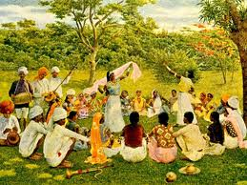
JUNE 15th:
1863:
The steamship, Mars arrived on St. Croix from Calcutta with 318 East Indian workers to supplement the plantation labor force.
Courtesy:
Text: From Serfdom to FireBurn and Strike, Peter Hoxcer Jensen, Page 186
Picture: http://www.southasianconcern.org/south_asians/detail/why_did_south_asians_leave_their_homelands/

Slide 19
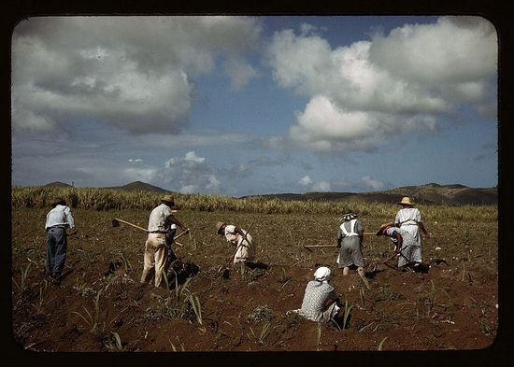
JUNE 16th:
1879:
The Landsthing passed a bill into law to help the destitute in Frederiksted. It particularly helped the laborers, since they were not eligible for the loans and grants made available to the planters.
Courtesy:
Text: The Umbilical Cord, HWL Willocks, Page 217
Picture: http://johnedwinmason.typepad.com/john_edwin_mason_photogra/farm-security-administration/page/2/

Slide 20
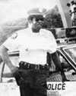
JUNE 17th:
1946:
Richard Nicholas Callwood, a highly commended and decorated police officer was born in Cane Garden Bay, Tortola, BVI. The police precinct is named in his honor.
Courtesy of:
Text: Funeral Booklet, Pages 4-5
Picture: http://www.odmp.org/officer/2694-police-officer-richard-n-callwood

Slide 21
JUNE 18th:
1934:
Elmira Agatha Thomas Farrell was born on St. Thomas. She is noted as a traditional games expert, medicinal leaves and herbs specialist, senior citizen advocate, cultural specialist, auxiliary officer, cultural dance performer and entertainer.
Courtesy of:
Text: Funeral Booklet, Pages 1 and 2
Picture: Funeral Booklet

Slide 22
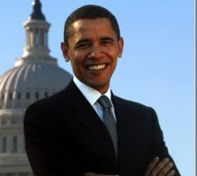
JUNE 19th:
1920:
After the co-founding of the Liberty Party, a “Negro” political body, Hubert Harrison expressed in the Negro World, the ideas of a Negro Party in American politics, and a Negro candidate for the US presidency of America. Eighty-eight years later, Barack Obama achieved that goal.
Courtesy of:
Text: Hubert Harrison Reader, Page 149
Picture: http://www.treehugger.com/files/2008/04/obama-goes-for-public-transportation-vote.php

Slide 23
JUNE 20th:
1918:
By insistence of the Naval Administration, the Colonial Council of St. Croix passed an ordinance regulating alcohol consumption and forbade its importation, manufacture, and sale except for medicinal, sacramental, industrial, and scientific uses.
Courtesy of:
Text: Umbilical Cord, H.W.L. Willocks, page 270
Picture: http://antoniofarinha.com/blog/page/40/

Slide 24
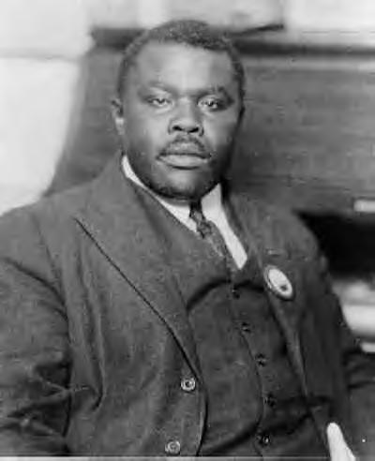
JUNE 21st:
1923:
Marcus M. Garvey, protégée of Hubert H. Harrison and President — General of UNIA was found guilty of mail fraud and sentenced to five years in prison, fined $1,000.00, and the cost of the lawsuit.
Courtesy of:
Text: Hubert H. Harrison Reader, Page 194
Picture: http://www.africawithin.com/garvey/garvey_bio.htm

Slide 25
JUNE 22nd:
1954:
The House of Representatives adopted its own version of the Revised Organic Act of 1954.
Courtesy of:
Text: Umbilical Cord, H.W.L. Willocks, page 327
Picture: http://house.of.representatives.vote.no.suckered.us/

Slide 26
JUNE 23rd:
1941:
Carlos A. Cooks founded the African Nationalist Pioneer Movement. Many Virgin Islanders played pivotal roles and promoted African nationalism through race pride, economic, educational, and social uplift, self reliance and protection and guardians of Africa’s legacy. It was an outgrowth of Marcus Garvey’s United Negro Improvement Association (UNIA) endorsed by Virgin Islander, Hubert H. Harrison.
Courtesy:
Text: The Street Speaker
Picture: http://www.jewishdictionary.co.il/u/united-negro-im.asp

Slide 27
JUNE 24th:
1954:
The US Navy began diving and underwater explosives training on St. Thomas. The maneuvers were scheduled to end on June 30th.
Courtesy of:
Text: Daily News
Picture: http://www.the-peoples-forum.com/cgi-bin/readart.cgi?ArtNum=23187

Slide 28
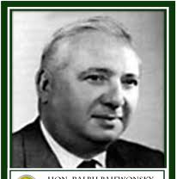
JUNE 25th:
1954:
The Daily News questioned Governor Paiewonsky’s selling of over a thousand acres of land “to the highest bidder” on St. Croix. The selling of this land eliminated the prospect of developing a citrus farming project.
Courtesy of:
Text: Thoughts Along The Way, Page 341
Picture: http://www.hlscc.org/lrc/index.php?option=com_oziogallery2&view=04carousel&Itemid=147

Slide 29
JUNE 26th:
1916:
Magnus O. “Mungo” Niles, musician, performer, dancer, choreographer, cultural production expert, talent agent, and tradition bearer, was born on St. Thomas, Danish West Indies.
Courtesy of:
Text: The Mungo Niles Cultural Dancers 1985 Goodwill Tour Booklet, Pages 4-5
Picture: http://webpac.uvi.edu/imls/pi_uvi/profiles1992/Aesthetes/Niles_M/index.shtml

Slide 30
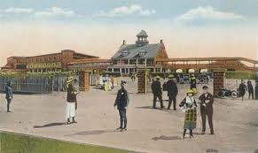
JUNE 27th:
1945:
A horse racing card for July 1st at Sugar Estate Race Track was announced with a Governor’s Cup purse of $77.00 for first place and $23.00 for second.
Courtesy of:
Text: Daily News
Picture: http://maryforney.blogspot.com/2009_01_01_archive.html

Slide 31
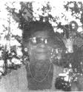
JUNE 28th:
1896:
Medora Jackson was born on St. Croix. She was an educator and educational administrator for 45 years, who taught governors, judges and teachers in whose honor monuments were named.
Courtesy of:
Text: Legislative Act
Picture: http://www.stx.k12.vi/profiles/JacksonM.htm

Slide 32
JUNE 29th:
1954:
Governor Archie Alexander and his team met with the St. Thomas Development Authority Board on the Department of Interior’s transfer of property at Bournefield and Submarine Base to the Virgin Islands Corporation. It terminated a lease without giving the Municipality the required 60 days notice. Governor Alexander let the Board know it had no recourse.
Courtesy of:
Text: Daily News
Picture: http://www.flickr.com/photos/vieilles_annonces/3790001014/

Slide 33
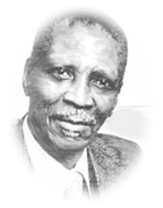
JUNE 30th:
1974:
Guy Benjamin retired from public service. He was a teacher, educational administrator, and author.
Courtesy of:
Text: Legislative Act
Picture: http://www.stx.k12.vi/profiles/Benj_Guy.htm

Slide 34
DIVISION OF VI CULTURAL EDUCATION
ST. CROIX
2133 Hospital Street, C’sted, STX, VI 00822
3012 Estate Golden Rock, Suite 4B, C’sted, STX, VI 00820
340-718-3645 x: 3, 1 or 2*.* 340-719-6429 (fax)
vbryson@vide.vi
ST. THOMAS / ST. JOHN
1834 Kongens Gade, STT, VI 00802
J. Antonio Jarvis Annex, STT, VI 00802
340-774-0100 x: 2809, 2806, 2804 or 2808*.* 340-777-4342 (fax)
Yohance.henley@vide.vi; or mmartin@vide.vi

