Slide 1
AUGUST 2017
HISTORICAL CULTURAL CALENDAR
COMPLIMENTS OF:
VIRGIN ISLANDS DEPARTMENT OF EDUCATION
DIVISION OF VIRGIN ISLANDS CULTURAL EDUCATION

Slide 2
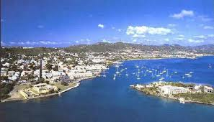
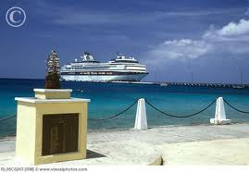
….. SPECIAL FEATURE …..
HARBORS OF THE USVI
Christiansted Harbor, St. Croix, USVI
Frederiksted Harbor, St. Croix, USVI
Courtesy of:
St. Croix (Christiansted Harbor): http://www.stcroixtourism.com/st_croix_pictures/christianstedharbor.htm
St. Croix (Frederiksted Harbor): http://www.visualphotos.com/image/1x9151246/shoreview_frederiksted_st_croix_us_virgin_islands

Slide 3
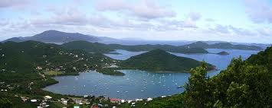
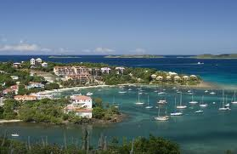
….. SPECIAL FEATURE …..
HARBORS OF THE USVI
Coral Bay Harbor, St. John, USVI
Cruz Bay Harbor, St. John, USVI
Courtesy of:
St. John (Coral Bay Harbor): http://coralbaystjohn.com/
St. John (Cruz Bay Harbor): http://seestjohn.com/st_john_life/st-john-virgin-islands/cruz-bay-st-john-virgin-islands-19732009/

Slide 4
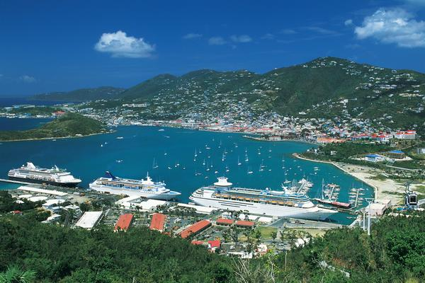
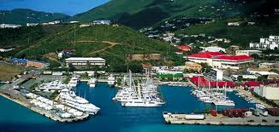
….. SPECIAL FEATURE …..
HARBORS OF THE USVI
Charlotte Amalie Harbor, St. Thomas, USVI
Crown Bay Harbor, St. Thomas, USVI
Courtesy of:
St. Thomas (Charlotte Amalie Harbor): http://traveltips.usatoday.com/tips-places-usvi-59484.html
St. Thomas (Crown Bay): http://www.dogsledsportfishing.com/contact-us/

Slide 5
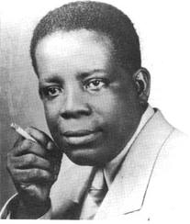
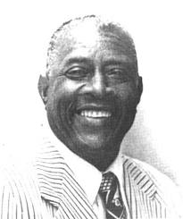
AUGUST 1st:
1930:
The Virgin Islands Daily News was founded by J. Antonio Jarvis and Ariel Melchoir.
Courtesy of:
Text: Thoughts Along the Way Ariel Melchoir, Page 1
Pictures: http://www.stx.k12.vi/profiles/Jarvis.htm and http://www.stx.k12.vi/profiles/Melchior.htm

Slide 6
AUGUST 2nd:
2001:
Lieutenant Governor Gerard L. James asked Governor Charles Turnbull to veto the Video Lottery Terminals (VLT) provision in the Supplemental Appropriation; he called it the Kiss of Death for casino gaming locally.
Courtesy of:
Text:
Picture: http://www.revistainterforum.com/english/articles/072202collins_usvi.html

Slide 7
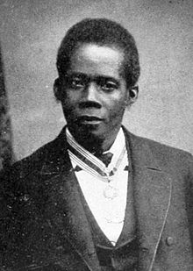
AUGUST 3rd:
1833; Edward Wilmot Blyden, Father of Pan- Africanism, author, orator and statesman, was born on the island of St. Thomas.
Courtesy of:
Text:
Picture: https://en.wikipedia.org/wiki/Edward_Wilmot_Blyden

Slide 8
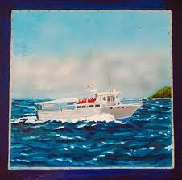
AUGUST 4th:
1973:
The Nicole Robin, which was purchased for the Boynes Ferry Fleet, was returned from Cuba.
Courtesy of:
Text:
Picture: http://www.stjohnsuntimes.com/node/11050

Slide 9
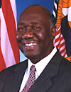
AUGUST 5th:
2003:
Governor Charles W. Turnbull signed a provision into law. It effectively killed the 2 cents per round import tax.
Courtesy of:
Text & Picture: https://www.nga.org/cms/charles-w-turnbull

Slide 10
AUGUST 6th:
2009:
The Daily News announced that the Elrod Hendricks West 9-10 All Stars became the only VI Little League to advance to the regional semifinals in Aguadilla, Puerto Rico.
Courtesy of:
Text: Daily News, 2009
Picture: https://en.wikipedia.org/wiki/Elrod_Hendricks

Slide 11
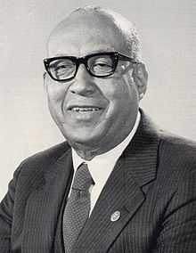
AUGUST 7th:
1917:
Melvin H. Evans, born in St. Croix, was the last appointed governor and the 1st elected governor. He also became the 1st Virgin Islander to be named ambassador to the island nation of Trinidad and Tobago.
Courtesy of:
Text
Picture: https://en.wikipedia.org/wiki/Melvin_H._Evans

Slide 12
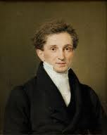
AUGUST 8th:
1777:
Johannes Sobotker, who owned large holdings in the West Indies and Denmark, was born in St. Thomas. His power escalated from acting governor, appointed vice governor general in 1832 and named governor general of the Danish West Indies in 1834 and named governor of St. Thomas in 1835 until 1848 when he retired from this position.
Courtesy of:
Text: Profiles of Outstanding Virgin Islanders Ruth Moolenaar, Page 202
Picture: http://ookaboo.com/o/pictures/source/2428569/Ramblersen

Slide 13
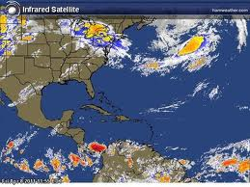
AUGUST 9th:
2000:
The St. Thomas/St. John National Weather Service meteorologist, Anthony Reynes reported the Virgin Islands is “out of the woods” for Hurricane Alberto. This meant Hurricane Alberto was no longer a threat to the Virgin Islands.
Courtesy of:
Text: Daily News, Page 3
Picture: http://beta2.tbo.com/weather/weather/2010/sep/28/cold-front-key-to-storm-systems-destination-ar-27698/

Slide 14
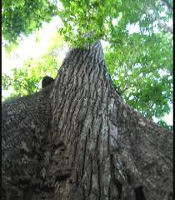
AUGUST 10th:
1962:
150 year old Mahogany trees in Altona, St. Thomas fell prey to the axe and the saw to give “access to private property.” These trees, which were on government property, were landmarks of an era when the island was less populated and naturally more beautiful .
Courtesy of:
Text: Thoughts Along the Way, Ariel Melchoir, Sr. Page 320
Picture: http://todaysseniorsnetwork.com/mahogany_cure.htm

Slide 15
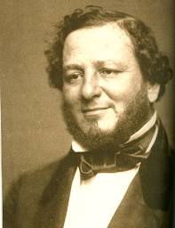
AUGUST 11th:
1811:
Judah P. Benjamin, a Jewish confederate statesman, brain of the confederacy, world’s best orator, and writer, was born on St. Croix. He was known for being a leading statesman of the confederacy.
Courtesy of:
Text: From These Shores, Axel C. Hansen
Picture: http://jewishcurrents.org/november-21-%E2%80%9Cthe-brains-of-the-confederacy%E2%80%9D-3246

Slide 16
AUGUST 12th:
1944:
The Daily News stated the Department of Education had a difficult time finding able teachers to employ in the public schools. In spite of their efforts, this problem is as great today as it ever was.
Courtesy of:
Text: Thoughts Along the Way Ariel Melchoir, Sr., Page 122
Picture: http://www.viwib.org/links.htm

Slide 17
AUGUST 13th:
1939:
Dr. Wilburn Alexander Smith, Jr., was born on St. Thomas. From 1979 until his death in 1987, he was appointed to the Assistant Commissionership of the Department of Education. He was a consummate professional, who was devoted to effecting improvement in our educational system.
Courtesy of:
Text & Picture: Funeral Booklet

Slide 18
AUGUST 14th:
2008:
The Virgin Islands Water and Power Authority (WAPA) used its last credit to pay HOVENSA. WAPA’s board called an emergency meeting to approve the drawdown of the last $2 million of a recently acquired $20 million line of credit.
Courtesy of:
Text: The Avis, Page 2
Picture: https://www.customerservice.viwapa.vi/Click2GovCXP/Index.jsp

Slide 19
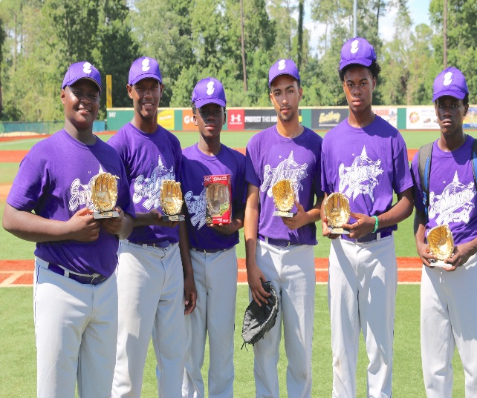
AUGUST 15th:
2011:
The Daily News reported that the St. Thomas Baseball Explorers 12 returned from Myrtle Beach, Va., the same way they had left St. Thomas --without a loss.
Courtesy:
Text: Daily News, 2011
Picture: http://www.sttsports.com/Stt-Sports-Photo-Galleries-/ExplorersBaseball/2016-12U-and-14U-to-Ripken-in-/

Slide 20
AUGUST 16th:
1965:
The College of the Virgin Islands accepted a second challenge from the Rockefeller Brothers Fund. The institution of higher learning successfully raised over $900,000.00 to receive $100,000.00 from the Foundation.
Courtesy of:
Text: Thoughts Along the Way Ariel Melchoir, Sr., Page 351
Image: http://freemasonrywatch.org/rockefeller_foundation.html

Slide 21
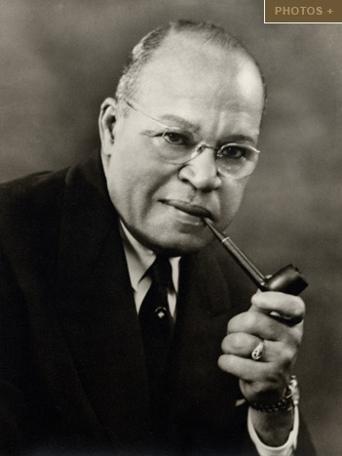
AUGUST 17th:
1955:
The White House announced that Archie Alexander, a wealthy construction pioneer who replaced DeCastro as Governor of the Virgin Islands had to resign because of “poor health”.
Courtesy of:
Text: The Umbilical Cord, Harold W.L. Willocks, page 331
Image: http://www.nasonline.org/site/PageServer?pagename=AAHP_Database_Bio_Alexander

Slide 22
AUGUST 18th:
2001:
The Daily News announced the Virgin Islands is taking part in the university games. A delegation of the Virgin Islands college athletes will swim, serve, and dribble against some of finest university athletes in the world.
Courtesy of:
Text: The Daily News Sports, Page 29
Image: http://pressitt.com//public/files/2012/01/29/9411/University-Games-Logo.jpg

Slide 23
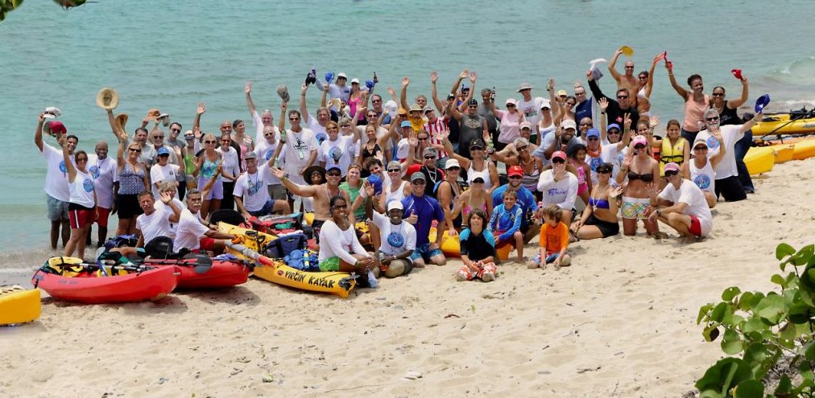
AUGUST 19th:
2008:
For the third time since 2007, Kind Addiction Group, a Boston organization, volunteered at Queen Louise Home for Children on St. Croix. They assisted local disadvantaged children.
Courtesy of:
Text: The Avis, page 2
Image: http://www.lssvi.org/kayak.html

Slide 24
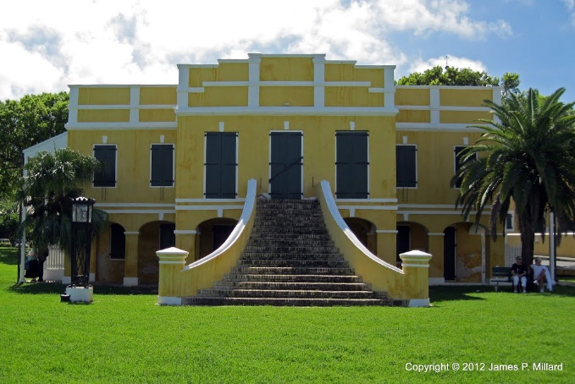
AUGUST 20th:
2013:
The Christiansted National Historic Site in St. Croix opens its new exhibit about Christiansted and the history of its neighborhood, bringing memories alive and inspiring more preservation of the islands history.
Courtesy of:
Text
Picture: http://www.panoramio.com/photo/82486353

Slide 25
AUGUST 21st:
1935:
Lawrence W. Cramer was appointed the 2nd civilian governor of the Virgin Islands.
Courtesy of:
Text:
Picture: https://tl-ph.login.facebook.com/pages/Lawrence-W-Cramer/110199689030161?_fb_noscript=1

Slide 26
AUGUST 22nd:
1966:
The Department of Public Safety made a sensible decision to prevent cars from entering the new concrete strip west of the now Alvaro DeLugo Post Office, Emancipation Gardens on St. Thomas. This restricted it to pedestrian traffic only.
Courtesy of:
Text: Thoughts Along the Way Ariel Melchoir, Sr., Page 367
Picture: http://flagspot.net/flags/vi%5Epd.html

Slide 27
AUGUST 23rd:
1942:
Julio Brady was born on St. Thomas. In 1979, he was the chief prosecutor in the Fountain Valley Murder Cases on St. Croix, which attracted national attention. In 1992, he was nominated Judge of the Virgin Islands Territorial Courts (now the Superior Court) and was later approved by the 19th Legislature.
Courtesy:
Text: Profiles of Outstanding Virgin Islands, Ruth Moolenaar, Page 29
Picture: http://webpac.uvi.edu/imls/pi_uvi/profiles1992/Governors/Brady_J/index.shtml

Slide 28
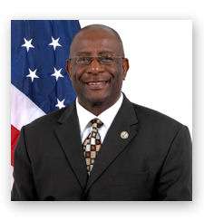
AUGUST 24th:
2005:
Police Commissioner Elton Lewis requested of the Senate Finance Committee a $21- million increase in the $40.6 million budget proposed by the governor the for V.I. Police Department in fiscal year 2006.
Courtesy of:
Text: United States Virgin Islands Daily News, page 21
Picture: http://www.vitema.gov/about/director.html

Slide 29
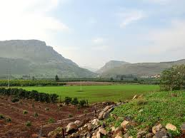
AUGUST 25th:
1734:
Rebels of 1733 Revolt in St. John turned themselves in.
Courtesy of:
Text:
Picture: http://ferrelljenkins.wordpress.com/2010/01/

Slide 30
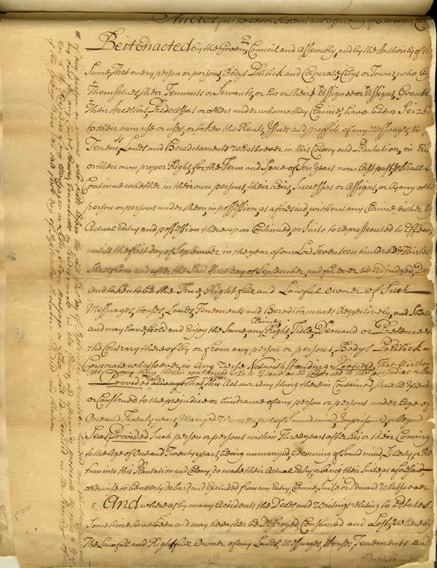
AUGUST 26th:
1903:
The Danish Royal Commission, that was appointed to investigate and report on the conditions of the islands, changed recommendations to the Colonial Law of 1863, took actions, and recommended a combined council and two municipal councils.
Courtesy of:
Text: The Umbilical Cord, Harold W. L. Willocks, Page 225
Picture: http://www.archives.nysed.gov/education/showcase/201001women/activities_dbq3.shtml

Slide 31
AUGUST 27th:
1929:
James Nathaniel Brewster, Sr. “Jamesie” was born in Frederiksted, St. Croix. He was noted for his contribution to Quelbe music as a musician and leader of Jamesie and the Happy Seven.
Courtesy of:
Text:
Picture: http://www.onepaper.com/caribiadigest/?v=d&i=&s=Limes:Out+da+Box&p=34230

Slide 32
AUGUST 28th:
1965:
Eleven senators of the Legislature of the Virgin Islands added $76,000.00 to their combined salaries and expenses making the cost of legislation for these islands around $360,000.00 annually with stipends for legislators the 3rd highest in the nation.
Courtesy of:
Text: Thoughts Along the Way Ariel Melchoir, Sr., Page 352
Picture: http://en.wikipedia.org/wiki/Legislature_of_the_Virgin_Islands

Slide 33
AUGUST 29th:
1975:
The Virgin Islands Public Television System, Channel 12 celebrated its 3rd anniversary of being on air. Today marks its 42nd year.
Courtesy of:
Text: Thoughts Along the Way Ariel Melchoir, Sr., Page 530
Picture: http://www.wtjx.org/about

Slide 34
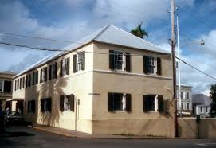
AUGUST 30th:
1680:
The Danish West India Company changed its name and became known as the Danish West India-Guinea Company. The name change reflected the company’s interest and expansion into the slave trade.
Courtesy of:
Text: Picture:https://commons.wikimedia.org/wiki/File:DANISH_WEST_INDIA_%26_GUINEA_COMPANY_WAREHOUSE.jpg

Slide 35
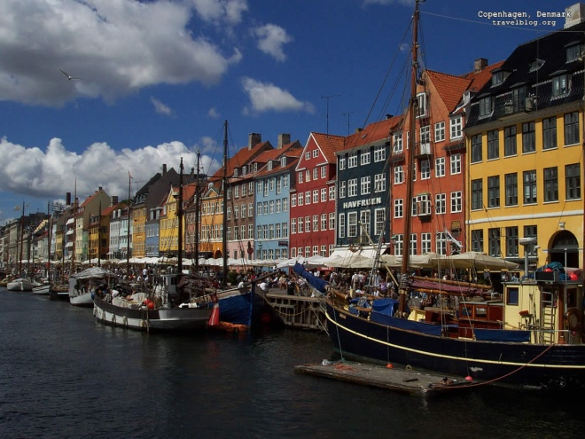
AUGUST 31st:
1671:
The Dutch captain, Arent Henriksen in the yacht “The Golden Crown” was dispatched in advance to make the necessary survey of the islands. The ‘Faero” , failed to arrive within the expected time, therefore Captain Henriksen returned to Denmark.
Courtesy of:
Text: A History of the Virgin Islands of the United States Isaac Dookhan, Page 38
Picture: http://www.travelblog.org/Wallpaper/copenhagen_denmark.html

Slide 36
DIVISION OF VIRGIN ISLANDS CULTURAL EDUCATION
To receive monthly complimentary electronic historical cultural calendar, kindly contact …..
ST. THOMAS / ST. JOHN
1834 Kongens Gade, STT, VI 00802
J. Antonio Jarvis Annex, STT, VI 00802
340-774-0100 x: 2804, 2806, or 2809*.* 340-777-4342 (fax)
yohance.henley@vide.vi; mmartin@vide.vi or vbryson@vide.vi
ST. CROIX
2133 Hospital Street, C’sted, STX, VI 00822
(340)773-1095 *.* 340-773-4476 (fax)

